Slide 1

Customer Shopping Behavior Analysis
Analyzing 3,900 purchases to uncover insights into spending patterns, product preferences, and subscription behavior for strategic business decisions.

Slide 2

Project Scope and Dataset Summary
Project Goal
Dataset Size
Uncover insights into spending patterns, customer segments, product preferences, and subscription behavior.
3,900 rows and 18 columns of transactional data.
Key Features
Includes demographics, purchase details (amount, category, size), and shopping behavior (discounts, reviews, frequency).
Notes:
"This project is an analysis of 3,900 customer purchases with the goal of uncovering insights into spending patterns, customer segments, and subscription behavior to drive strategy."

Slide 3




Exploratory Data Analysis (EDA) in Python
Missing Data Handling
Data Loading & Exploration
Imputed 37 missing values in the Review Rating column using the median rating of each product category.
Imported dataset using pandas; checked structure with df.info() and summary statistics with .describe().
Database Integration
Feature Engineering
Connected Python script to MySQL and loaded the cleaned DataFrame for SQL analysis.
Created age_group and purchase_frequency_days columns; standardized column names to snake case.
Notes:
"To do this, we used Python for data cleaning, which included imputing 37 missing review ratings and standardizing column names. We then loaded the clean data into MySQL for analysis."

Slide 4
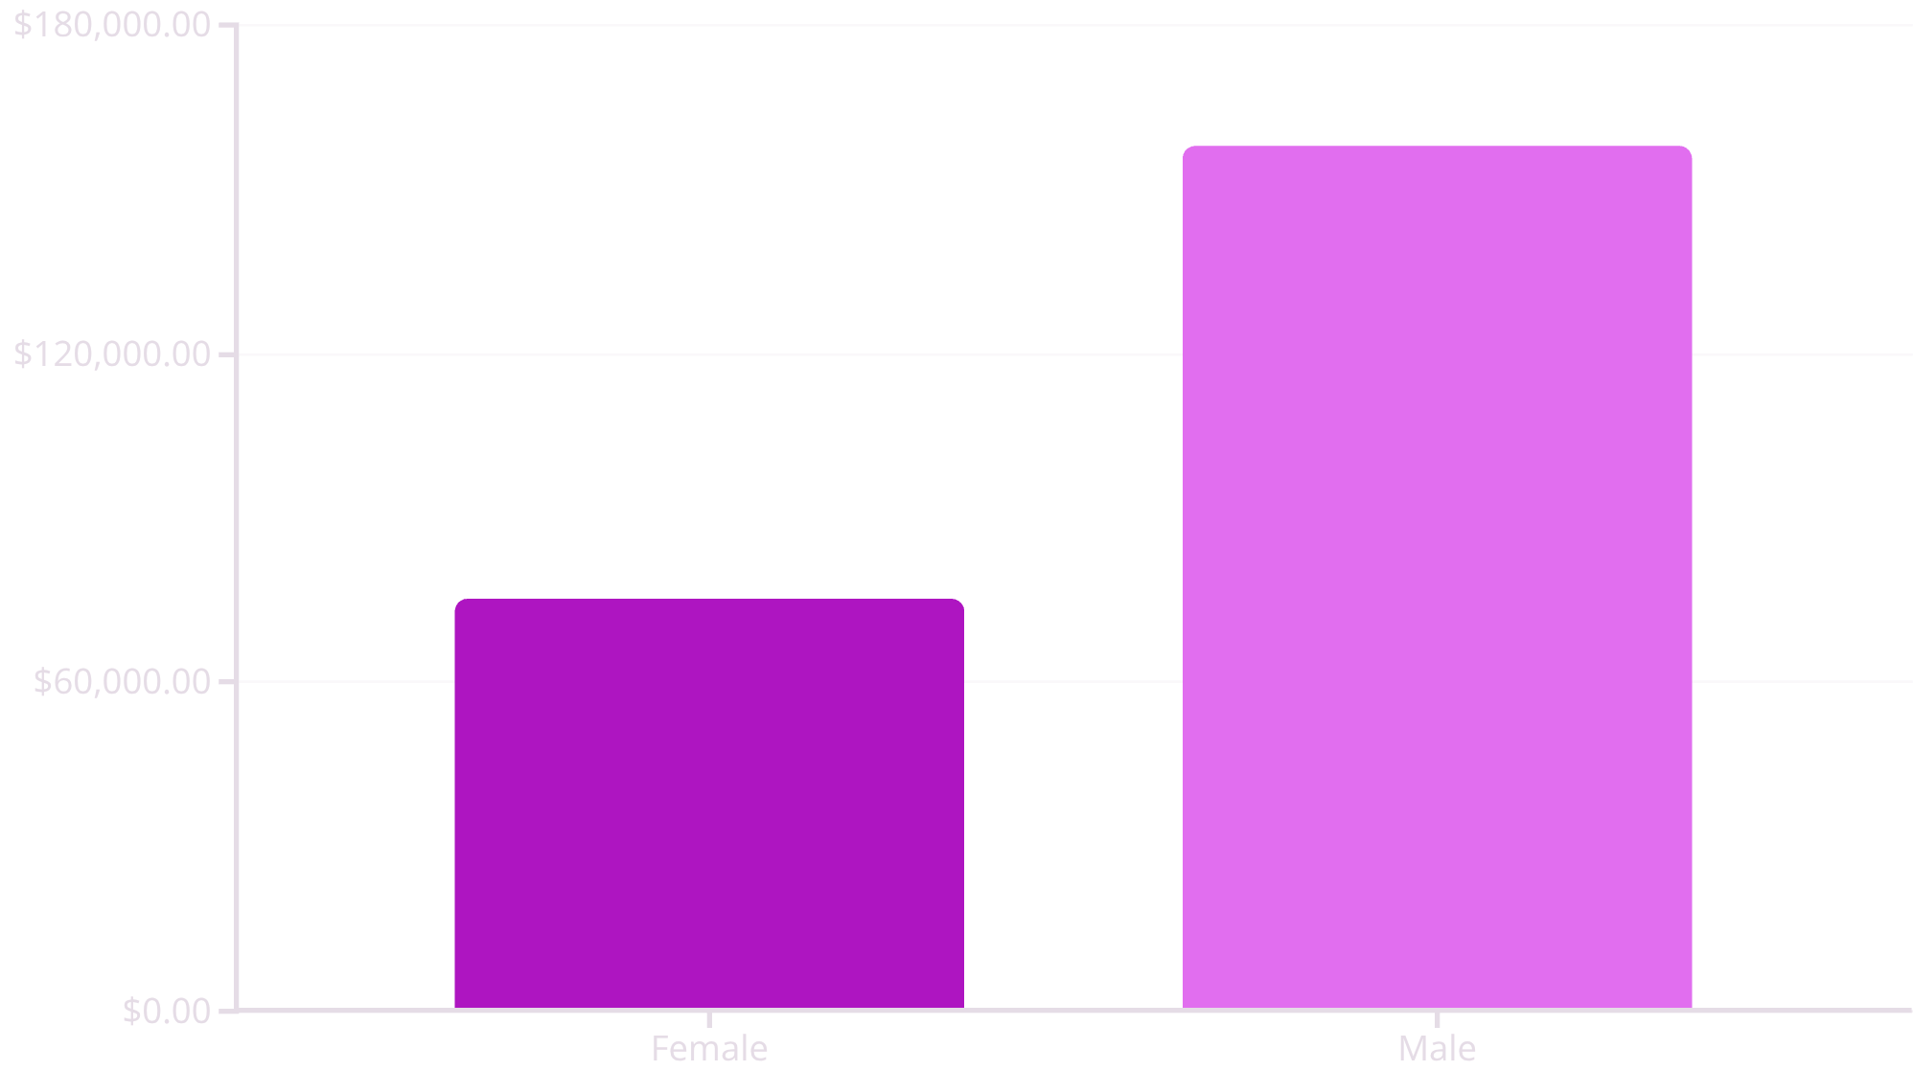
Key Metrics: Revenue and Spending
Revenue by Gender
Male customers generated significantly higher total revenue ($157,890) compared to female customers ($75,191).
Shipping Type Comparison
Express shipping users had a higher average purchase amount ($60.48) than Standard shipping users ($58.46).
Notes:
Our key findings are significant:
Revenue by Gender: Male customers generate more than double the revenue ($157k) compared to female customers ($75k).
Subscription Paradox: Surprisingly, non-subscribers generate far more total revenue ($170k) than subscribers ($62k). Most of our repeat buyers are not subscribers.

Slide 5
Subscription Impact and Customer Segmentation
Subscribers vs. Non-Subscribers
Non-subscribers generated higher total revenue ($170,436) than subscribers ($62,645), despite a slightly higher average spend for non-subscribers ($59.87 vs. $59.49).
Repeat Buyers & Subscriptions
Customers with more than 5 previous purchases are more likely to be non-subscribers (2,518 non-subscribers vs. 958 subscribers).
3116
701
83
Loyal Customers
Returning Customers
New Customers
The largest segment, based on purchase history.
A significant group for retention efforts.
The smallest segment, indicating potential for growth.
Notes:
Customer Segments: The vast majority of our customers are 'Loyal' , and 'Young Adults' are the highest-contributing age group."

Slide 6
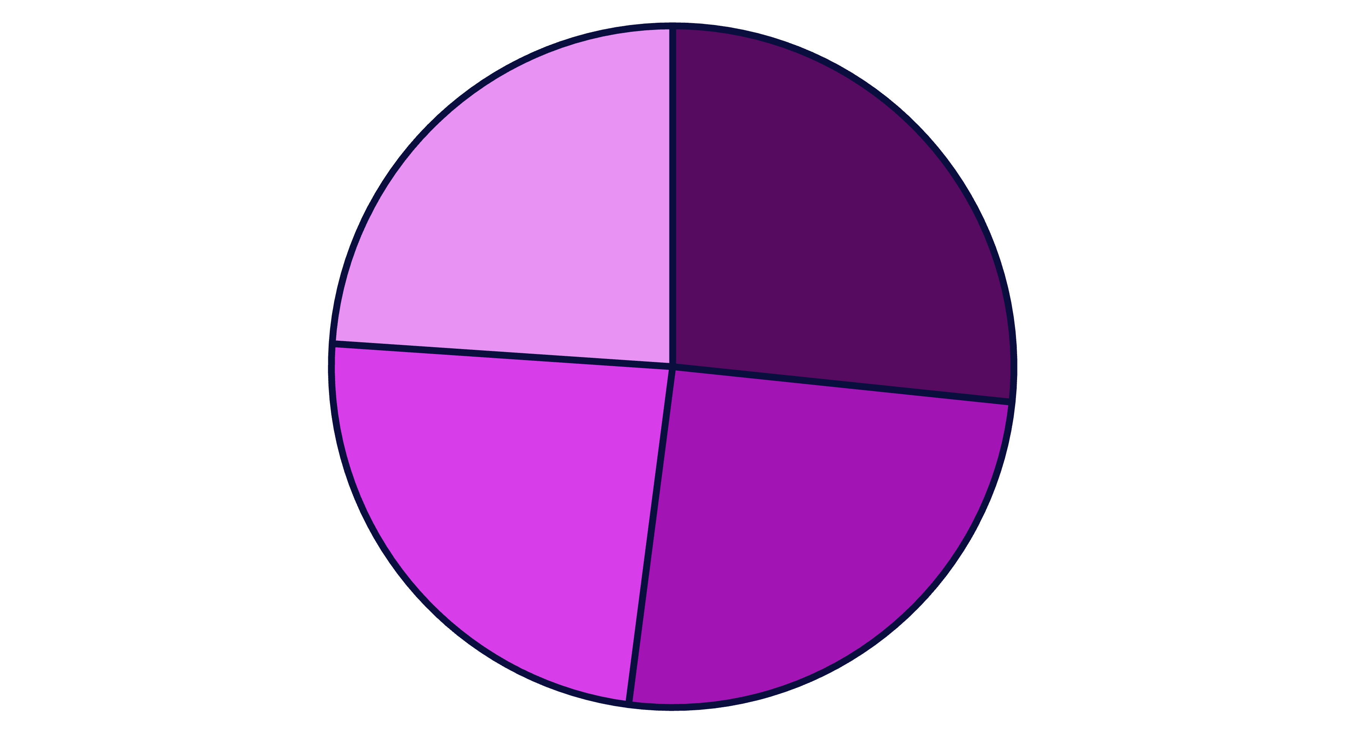
Age Group Revenue Contribution
Revenue is relatively evenly distributed across age groups, with Young Adults contributing the most.
Young adult
Senior citizen
Middle Age
Adult
Young Adult
Middle-aged
Adult
Senior
Notes:
"On the product side, Gloves and Sandals are our top-rated items. However, products like Hats and Sneakers are highly discount-dependent, with discount rates around 50%. The Hat is a key item that is both popular and highly price-sensitive.

Slide 7

Product Performance and Ratings
Top 5 Products by Average Rating
Top 5 Discount-Dependent Products
1
Gloves
Hat: 50.00% Discount Rate
3.86 Average Rating
Sneakers: 49.66% Discount Rate
2
Sandals
3.84 Average Rating
Coat: 49.07% Discount Rate
3
Boots
3.82 Average Rating
Sweater: 48.17% Discount Rate
4
Hat
Pants: 47.37% Discount Rate
3.80 Average Rating
5
Skirt
3.78 Average Rating
Note the Hat appears in both lists, suggesting high demand but price sensitivity.
Notes:
"On the product side, Gloves and Sandals are our top-rated items. However, products like Hats and Sneakers are highly discount-dependent, with discount rates around 50%. The Hat is a key item that is both popular and highly price-sensitive.

Slide 8
Top Products Per Category
1
Accessories
Jewelry
171
1
Clothing
Blouse
171
1
Footwear
Sandals
160
1
Outerwear
Jacket
163
2
Accessories
Sunglasses
161
2
Clothing
Pants
171
2
Footwear
Shoes
150
2
Outerwear
Coat
161
Notes:
Boost Subscriptions: Promote exclusive benefits to our large group of repeat, non-subscribing buyers.
Enhance Loyalty: Implement reward programs to move 'Returning' customers into the more valuable 'Loyal' segment.
Review Discounts: Strategically re-evaluate our discount policy on items like Hats and Sneakers to balance sales with profit margins.
Target Marketing: Focus campaigns on our highest-value groups—Young Adults and express-shipping users."

Slide 9
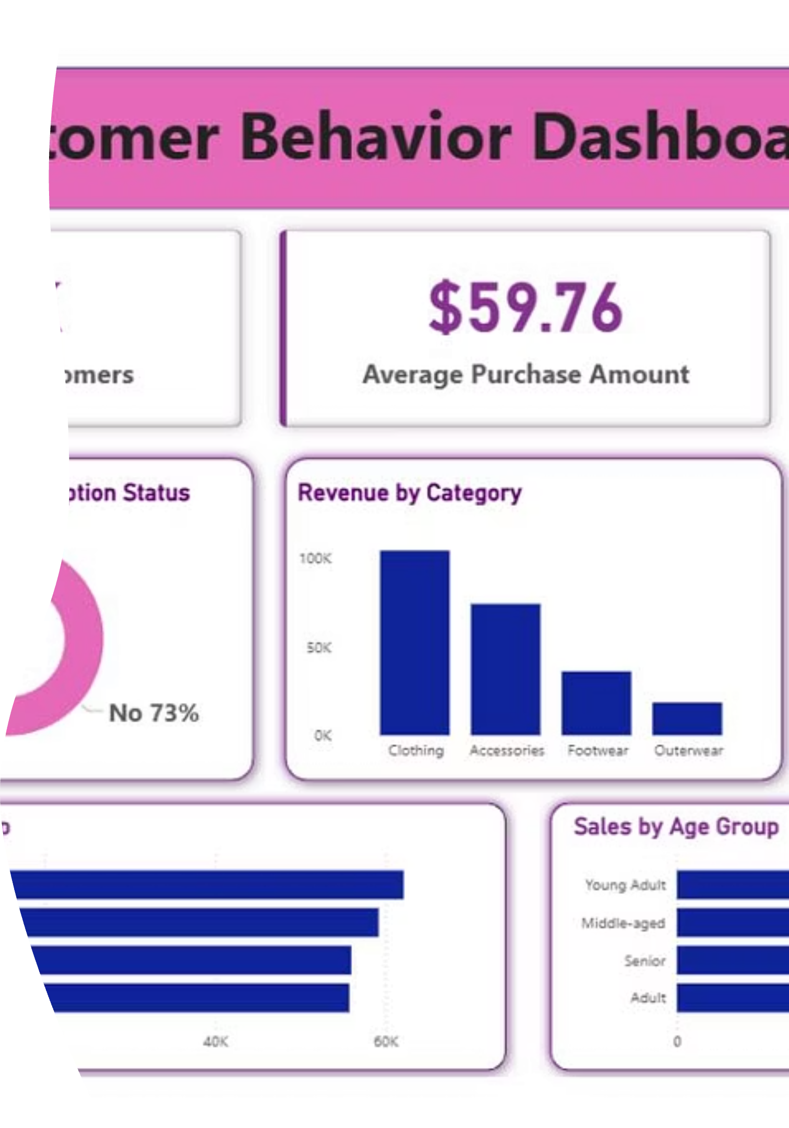

Visualizing Insights: Power BI Dashboard
An interactive dashboard was created in Power BI to present the findings visually, enabling stakeholders to explore the data dynamically.
The dashboard integrates all key metrics, from revenue by gender to product performance, providing a comprehensive view of customer behavior.
Notes:
Boost Subscriptions: Promote exclusive benefits to our large group of repeat, non-subscribing buyers.
Enhance Loyalty: Implement reward programs to move 'Returning' customers into the more valuable 'Loyal' segment.
Review Discounts: Strategically re-evaluate our discount policy on items like Hats and Sneakers to balance sales with profit margins.
Target Marketing: Focus campaigns on our highest-value groups—Young Adults and express-shipping users."

Slide 10




Strategic Business Recommendations
Boost Subscriptions
Customer Loyalty Programs
Promote exclusive benefits to increase subscriber conversion, especially among repeat buyers.
Implement rewards to move Returning customers into the highly valuable "Loyal" segment.
Review Discount Policy
Targeted Marketing
Strategically balance sales boosts from discounts with margin control, focusing on high-discounted items like Hats and Sneakers.
Focus campaigns on high-revenue age groups (Young Adults) and express-shipping users, and highlight top-rated products (Gloves, Sandals).
Notes:
Boost Subscriptions: Promote exclusive benefits to our large group of repeat, non-subscribing buyers.
Enhance Loyalty: Implement reward programs to move 'Returning' customers into the more valuable 'Loyal' segment.
Review Discounts: Strategically re-evaluate our discount policy on items like Hats and Sneakers to balance sales with profit margins.
Target Marketing: Focus campaigns on our highest-value groups—Young Adults and express-shipping users."

Slide 11
THANK YOU FOR YOUR ATTENTION

